Slide 1
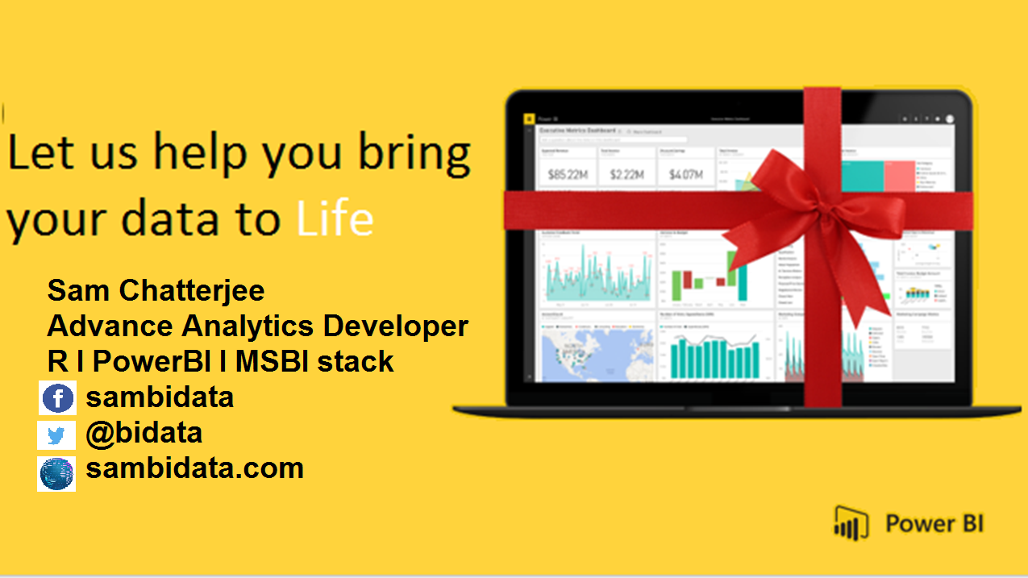

Slide 2

D A X
DATA ANALYSIS AND EXPRESSIONS

Slide 3
Why We need to Learn DAX?
DAX is a formula language associated with the Data modelling.
DAX contains important functions that can be use in Excel Power Pivot.
DAX is only associate with PowerBI.
It’s quite easy to create a new Power BI Desktop file and import some data into it. You can even create reports that show valuable insights without using any DAX formulas at all. But, what if you need to analyze growth percentage across product categories and for different date ranges? Or, you need to calculate year-over-year growth compared to market trends? DAX formulas provide this.
DAX associated with PowerBI

Slide 4
How will you Learn DAX?
By practicising it with your datasets.
By analysing the data and the query given.
What will you gain after DAX?
Creation of amazing data modelling and functions.
It works with relational databases that perform dynamic aggregations.
Can create the difference between excel and dax functions.

Slide 5

How a DAX function is written?

Slide 6
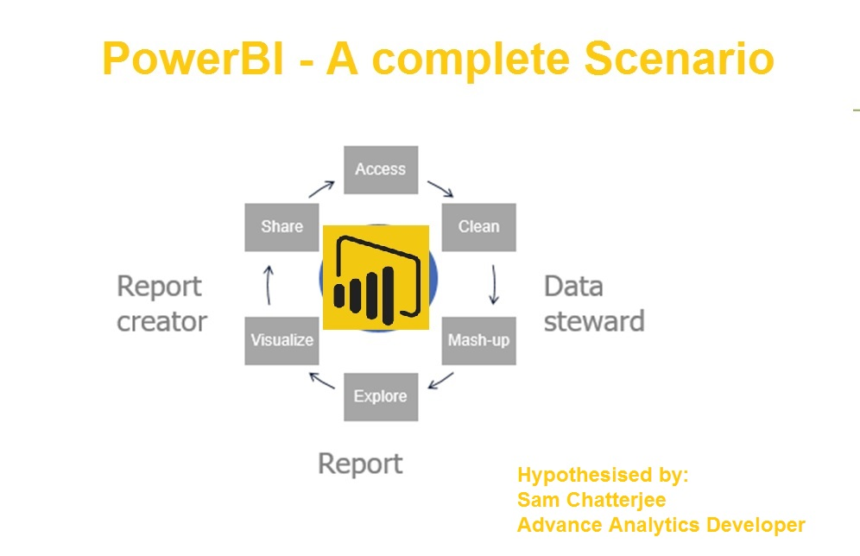

Slide 7
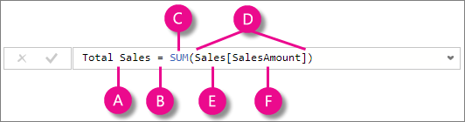

This formula includes the following syntax elements:
A. The measure name Total Sales.
B. The equals sign operator (=) indicates the beginning of the formula. When calculated, it will return a result.
C. The DAX function SUM adds up all of the numbers in the Sales[SalesAmount] column.
D. Parenthesis () surround an expression containing one or more arguments. All functions require at least one argument. An argument passes a value to a function.
E. The referenced table Sales.
F. The referenced column [SalesAmount] in the Sales table. With this argument, the SUM function knows on which column to aggregate a SUM.
When trying to understand a DAX formula, it is often helpful to break down each of the elements into a language you think and speak every day. For example, you can read this formula as:

Slide 8
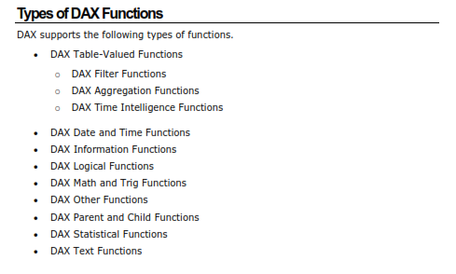
DAX Functions

Slide 9
DAX EXPRESSIONS
Each DAX function is hyperlinked to DAX functions details that have the DAX function description.
Each one is classifed based on
a) Descriptions
b) Syntax.
c) Parameters.
d) Return values.
e) Remarks.
f) Examples.
DAX functions parameters naming conventions
it facilitate the usage and understanding of the DAX functions.
it prefixes to the parameter names.
if the prefix is clear enough you can use the prefix itself as the parameter name.

Slide 10
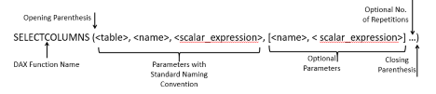
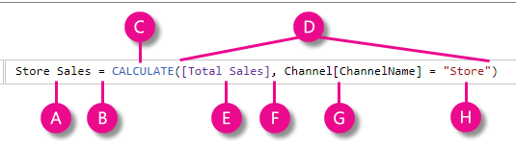
DAX FUNCTIONS

Slide 11
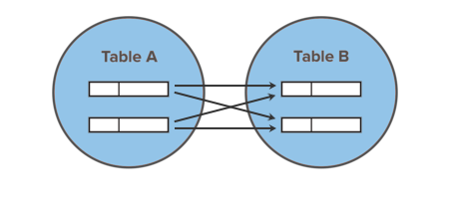
DAX
Cross Join the tables to find out the Winner
Returns a table that contains the Cartesian product of all rows from all tables in the arguments
CROSSJOIN( Colors, Stationery)
rA × rb × rC rows and cA + cB + cC columns
Ca/ra | cb
 | rb

Slide 12
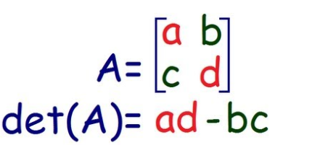
DAX Functions
Problems associated with crossjoin DAX functions
It is calculating row and columns together.
DAX mainly appear through row functions.
The concept of row and determinants are creating additional time consuming.
The real determinant is
Is taking too much of time.

Slide 13
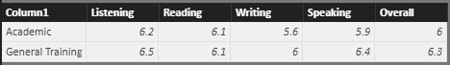
DAX Functions
Use subtract function
Columnrequested = (column[A] – column[B])
It returns a value that is given in each column not rows
Cardinality – All the values of any columns belongs to that particular column which doesnot move to any other table without further instructions.

Slide 14
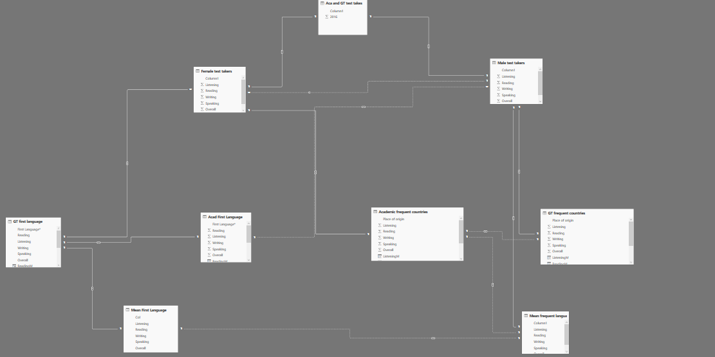
DAX Functions
The complete data model

Slide 15
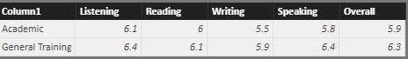
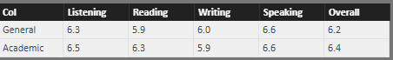
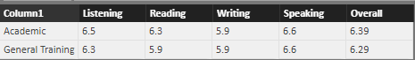
DAX Functions
Female test takers
Male test takers
Mean first language
Mean frequent countries

Slide 16
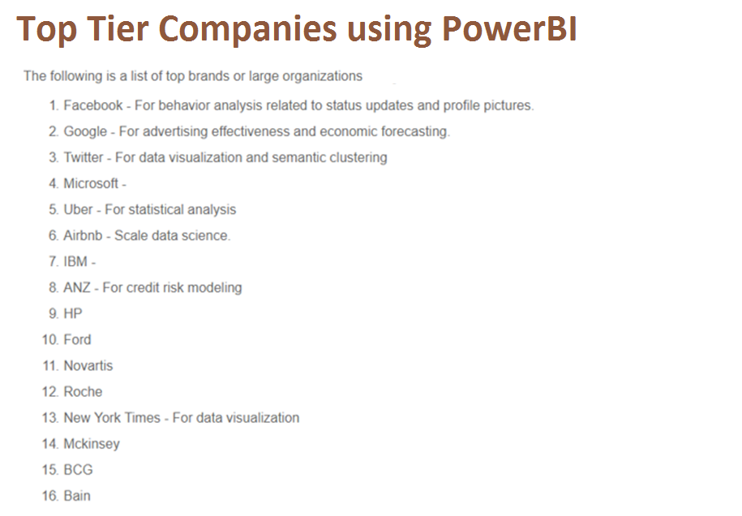
What will you achieve with PowerBI

Slide 17
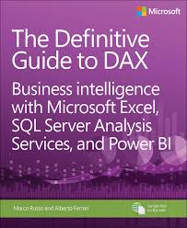
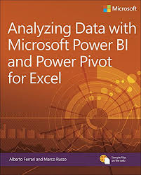
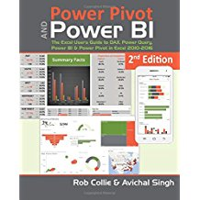
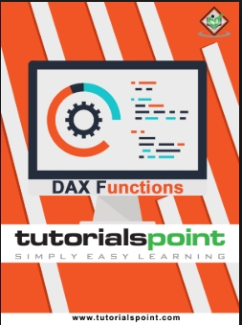
Resources
Get Power BI (Free) http://tinyurl.com/hj5hdg6
Power BI Jump Start http://bit.ly/1ktON16
Power BI Getting Started http://bit.ly/1FF88KA
Power BI Team Blog http://bit.ly/1vwbTLG
Power BI Channel 9 http://bit.ly/1a9Q0gv
Power BI https://powerbi.microsoft.com

Slide 18

Empower today’s innovators to unleash the power of data and reimagine possibilities that will improve our world

